Slide 1
Discrete Event Simulation of Risk™
Megan and Mary Taylor

Slide 2
Context Analysis
Game Play
History of Game

Slide 3
Requirements
The model shall…
  Determine the probability of world domination when having conquered each continent/set of continent

Slide 4
Problem and Need Statement
Risk uses both probability and strategy throughout the game.
Key strategies or key events that are most beneficial to success are unknown
There is a need for analysis to determine the best strategies and actions to take to lead to world domination.

Slide 5
CONOPS

Slide 6
Assumptions
Players keep the same strategy throughout the game.
Players use the maximum number of dice they can roll

Slide 7
Determining Winning Player

Slide 8
To-Do
Create Board as network that contain the markers:
  What territories your armies are in
  How many of your armies are in each territory
  What territories your opponents' armies are in
  How many armies your opponents have in each territory

Slide 9
Design of Experiment
Inputs
  Probability Threshold to attack

Slide 10
Design Alternatives
Strategies of where to place Armies:
  Defensive
    On Borders of your own territories
    On territories that have fewest armies
    On territories that have most armies
    On territories bordering enemy armies-proportional to their army size
  Offensive
    Place where enemy armies are weak
Strategies of where to attack:

Slide 11
Analysis
What is the best order to acquire territories

Slide 12
Bonus Armies vs Number of Invasion Paths

Slide 13
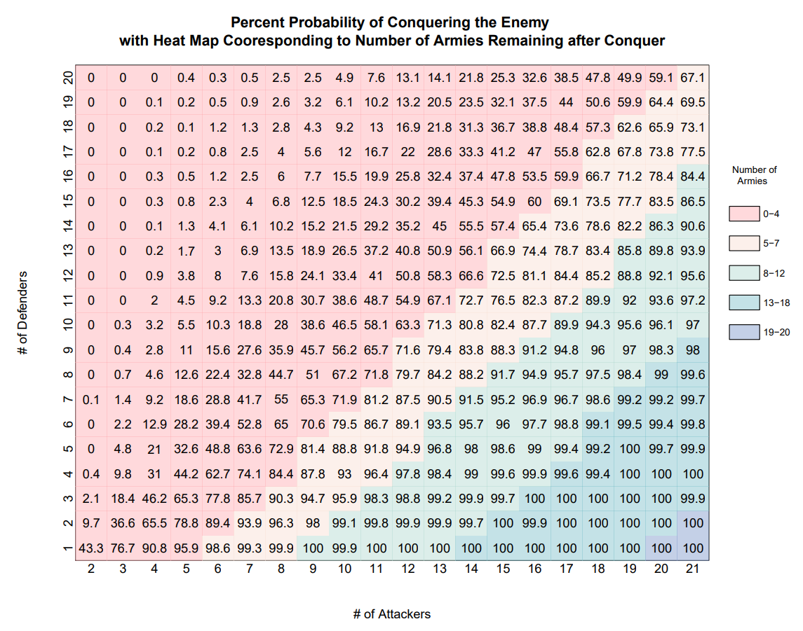
Probabilities of Conquering the Enemy
Developed using a Monte Carlo Simulation of Dice Rolls and the rules of the game

Slide 14
Code Architecture
Classes
  Board
    Make Board
    Place Initial Armies
  Player
    Roll Dice
    Attack
    Draw Cards
    Place Armies
      Get territories (based on enemy armies, your own armies…)
  Cards
    Draw Pile
    Discard Pile
  Dice

Slide 15
Steps of RISK™ Game Play
Game Set-up
  Give all players their sets of countries
  Players place armies based on given countries
Game Play
  i := 1..n (number of players)
  Player i gathers their armies based on:
    number of countries conquered
    Conquered continent bonus
    Turn in cards for armies
  Player i places their armies
  Player i decides if/where to attack
    Rolls dice to attack -> removes armies if lose
      Draw 1 card if conquer country
  Make strategic move
Based on Strategies

Slide 16
Future Work
Build AI to determine the best move
Build AI to determine probability of winning

